Slide 1




ion
IDEA TITLE: CryptoCurrency Flow & Investigation
Problem Statement: Fraud Detection in Financial Transactions
Team Name: Tech AI
Members: 1) Vinay Hipparge (Team Lead)
2) Aishwarya Tekale
3) Shriraj Vallamdeshi

Slide 2

PROTOTYPE OVERVIEW
Start
Prediction on new Data
Load Dataset
We are detecting Fraud/ Criminal Transaction Done in Ethereum Our Solution is not only focused on fraud Detection But also gave solutions on investigation methods after Fraud Detection, Below are methods of Fraud Detection and Investigation after Fraud Detection.
1. SVM for Fraud Detection
2. Dark Web Blacklisting Tool
3. Suspicious Address
4. Address Details and Transactions
5. Address Visualization
6. Address Clustering
Fraud Detection
Train Model
NO
Loading
New Dataset
Yes
Address Details
Visualization
End
Process Flow for Fraud Detection Chart

Slide 3


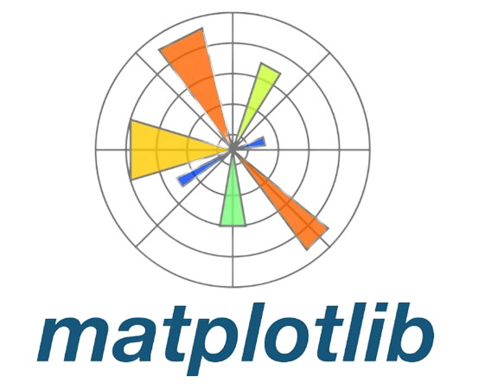





TECH STACK
USECASES
Use Case 1: Real-Time Fraud Detection (For Cryptocurrency Exchanges)
Actor: Security Analyst at a Cryptocurrency Exchange
Goal: Identify and prevent fraudulent transactions in real time.
Use Case 2: Dark Web Investigation (For Law Enforcement)
Actor: Law Enforcement Investigator
Goal: Identify and track Cryptocurrency addresses associated with illegal activities on the dark web.
Use Case 3: In-Depth Transaction Analysis (For Forensic Analysts)
Actor: Forensic Analyst investigating suspicious cryptocurrency activity.
Goal: Gather comprehensive data and analyze transaction patterns for fraud or criminal activity.
Use Case 4: Network Visualization and Pattern Recognition
Actor: Security Team at a Cryptocurrency Exchange or Financial Institution
Goal: Identify clusters of suspicious activity and visualize transaction networks for better understanding.
1. Front-End: HTML,CSS,JS
2. Back-End : Python, Flask or Django.
3. Libraries: Pandas, Numpy,
scikit-learn, Matplotlib, Beautiful Soup.
4. Database: Google Firebase

Slide 4

1) Fraud Detection
Description:
Our first tool focuses on identifying fraudulent transactions within a dataset containing real-world Ethereum transactions from a single day.
Key Features:
- Model Training: Uses the Support Vector Machine (SVM) algorithm.
- Data Balancing: Applied the SMOTE technique to prevent model bias.
- Training Model : Used Collected addresses from the dark web to train the model and identify similar patterns.
2) Dark Web Monitoring
Description:
Our second tool is designed to monitor and collect addresses from the dark web.
Key Features:
-Data Collection: Gathers addresses from illegal onion sites selling drugs, weapons, etc.
- Database Storage: Stores collected addresses in a secure database.
-Government Collaboration: Reports and helps terminate these addresses with government assistance.
3) Suspicious Address Detection
Description:
Our third tool identifies suspicious addresses based on transaction data from the last five days.
Key Features:
- Data Analysis: Analyzes a dataset containing transactions from the past five days.
- Identification: Detects addresses with the highest number of transactions or high Ether values.
- Suspicion Flagging: Flags the most suspicious addresses for further investigation.

Slide 5
4) Address Details
Description:
Our fourth tool provides comprehensive details about specific Ethereum addresses using the Etherscan API.
Key Features:
- Real-Time Data: Fetches real-time details by entering an Ethereum address.
-Transaction Summary: Provides total transactions sent and received, total amount sent and received, and time difference between the first and last transaction and other important Analytical Information.
-Detailed Listing: Displays all transaction details in a list format, downloadable as a CSV file for further investigation.
5) Visualization Tool
Description:
Our fifth tool allows users to visualize transaction data in a detailed and interactive manner.
Key Features:
- File Upload: Users can upload the CSV file downloaded from the Address Details tool.
- Graph Representation: Visualizes transactions as graphs with nodes representing addresses and edges representing transactions.
- Hover Feature: Displays address details, transaction time, and amount when hovered over a node.
- Insight Generation: Provides detailed insights into transaction patterns and identifies addresses with the most transactions.
6) Clustering Tool
Description:
Our sixth tool uses K-means clustering to categorize transactions by volume.
Key Features:
- Clustering: Groups transactions into categories such as low volume, medium volume, and high volume.
- Anomaly Detection: Identifies anomalies and potentially fraudulent addresses.
- Detailed Analysis: Helps in pinpointing addresses with numerous high-volume transactions, indicating suspicious activity.

Slide 6
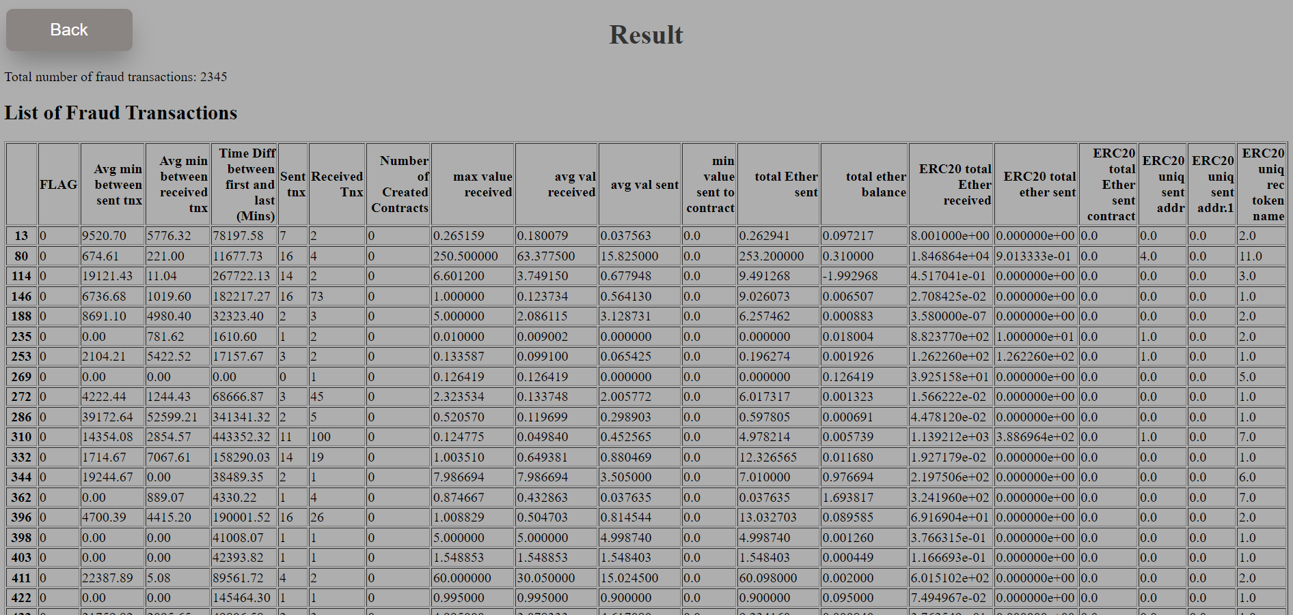
Outputs: 1. Fraud Detection using SVM

Slide 7
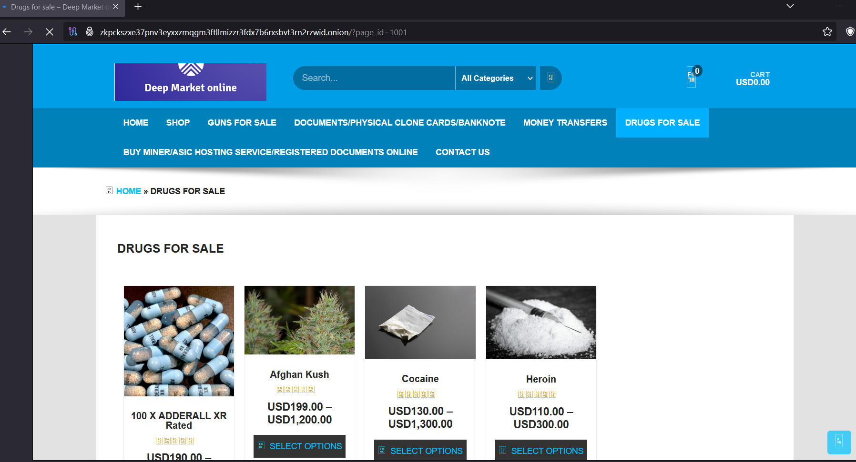
Outputs: 2. Dark Web

Slide 8
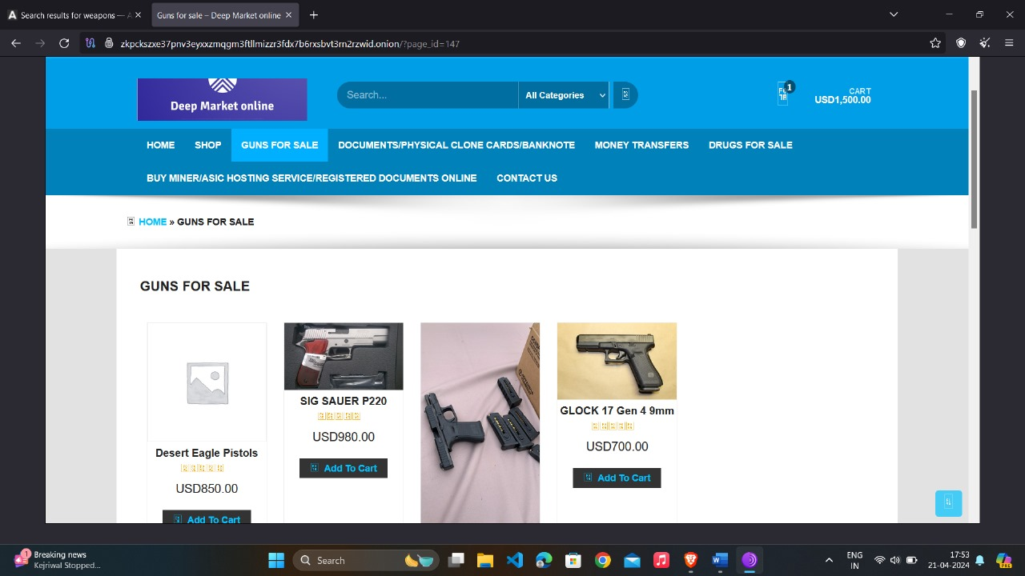
Outputs: 2. Dark Web

Slide 9
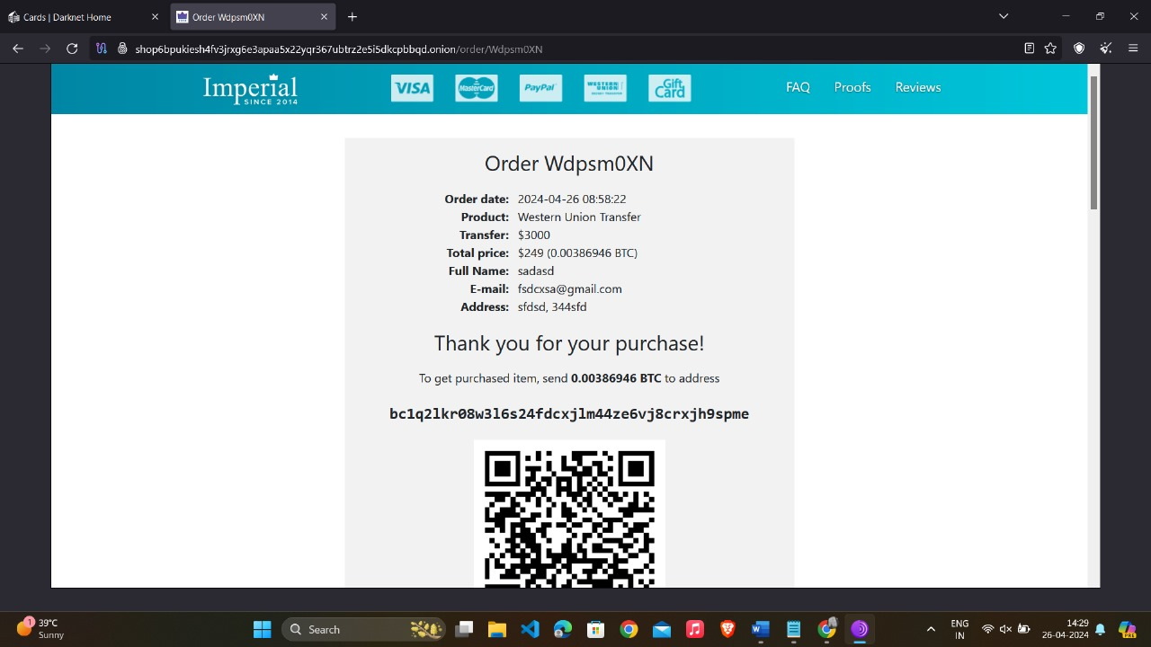
Outputs: 2. Dark Web
Payment Gateway of Website, collecting address of the Owner of websites

Slide 10
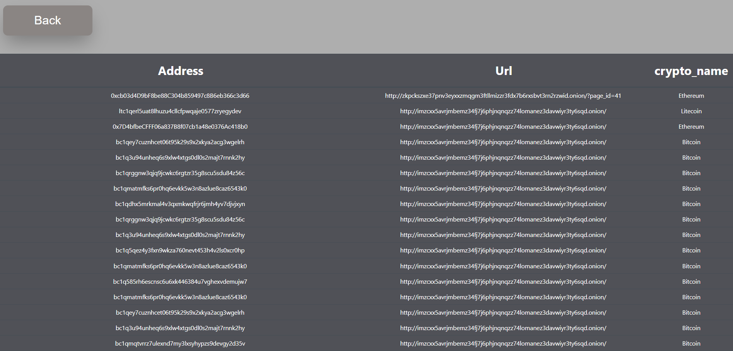
Outputs: 2. Dark Web
Storing the address collected from dark web in our Database with Url of Websites

Slide 11
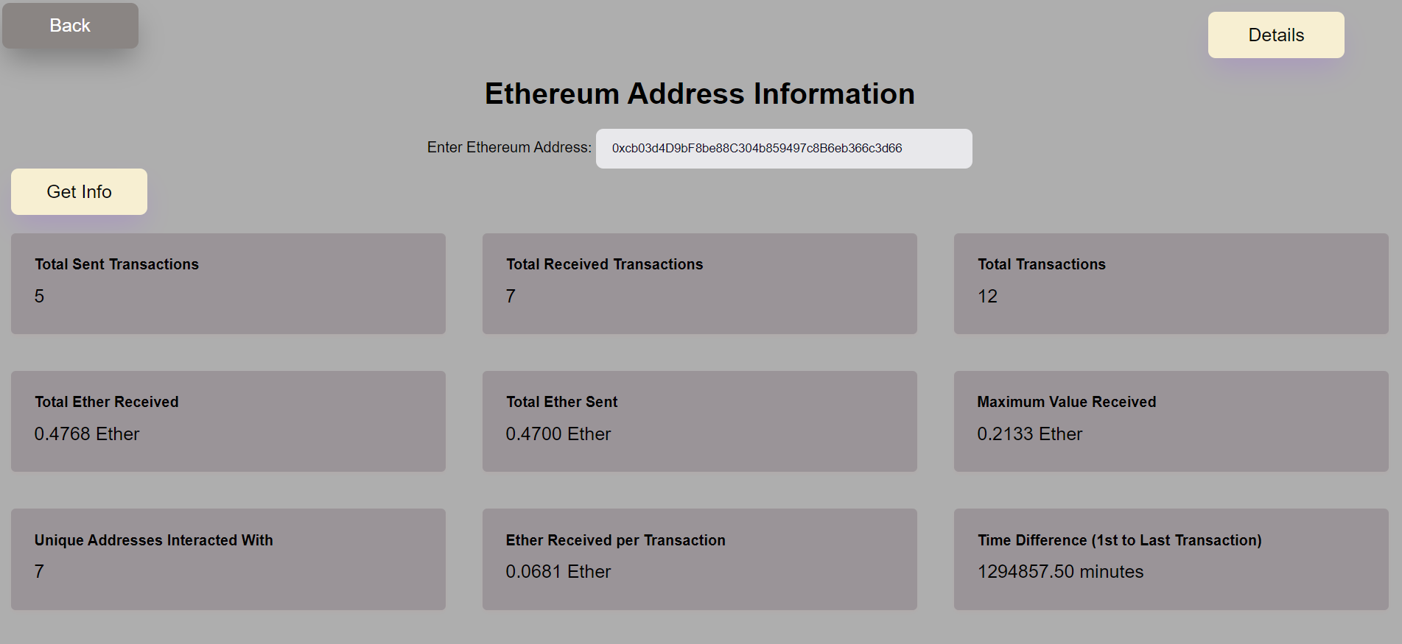
Outputs: 3. Address Details

Slide 12
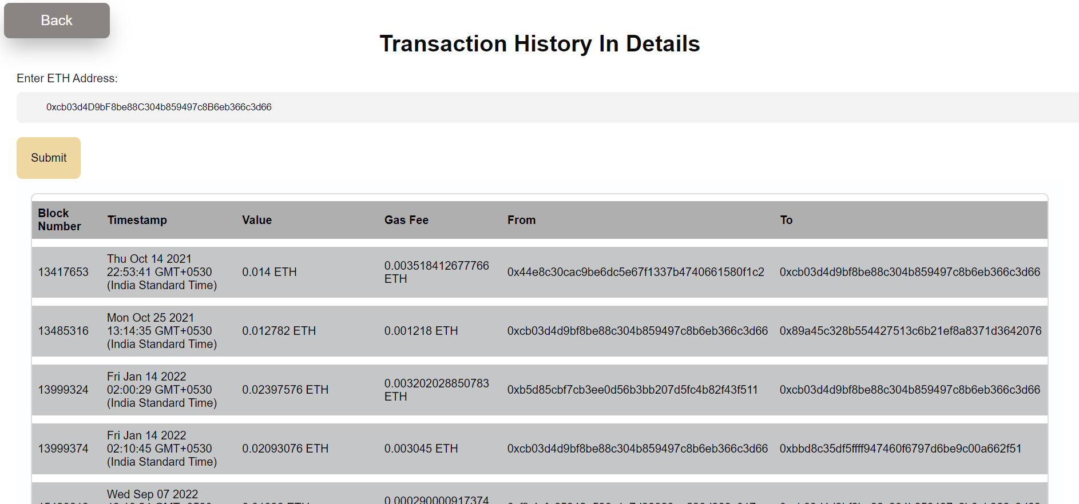
Outputs: 3. Address Details

Slide 13
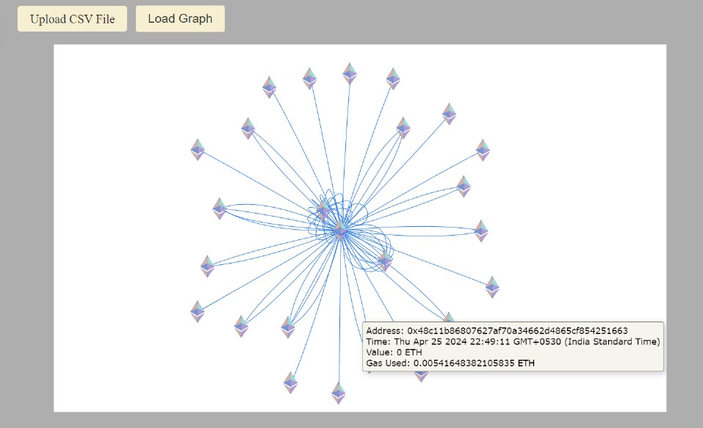
Outputs: 4. Address Visualization

Slide 14
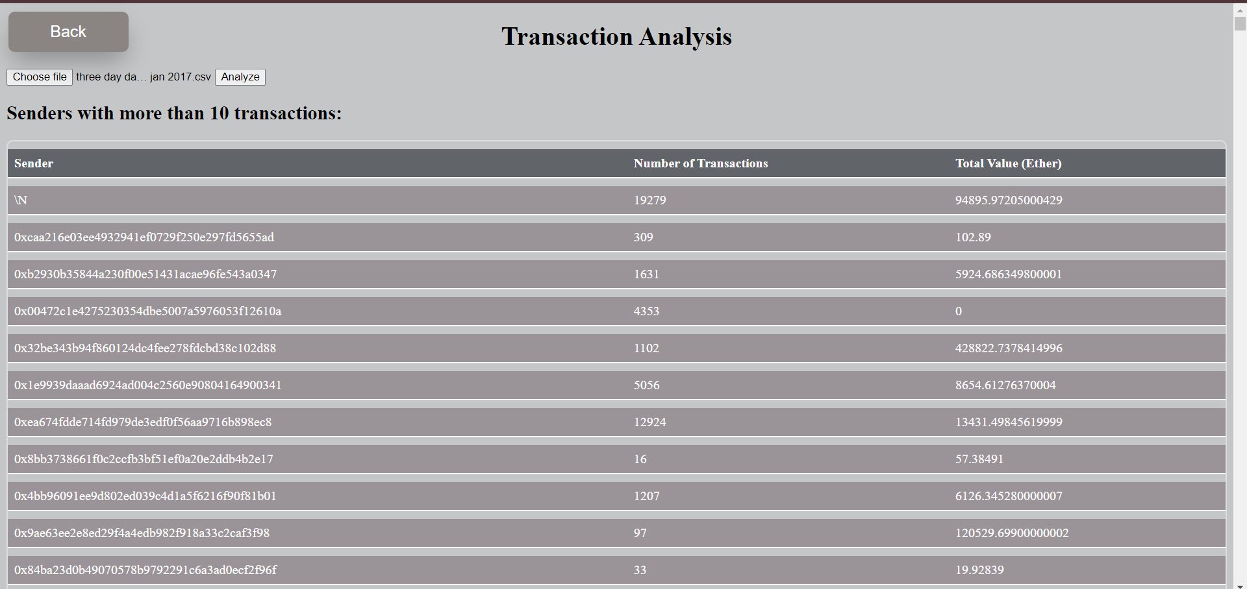
Outputs: 5. Suspicious Addresses

Slide 15
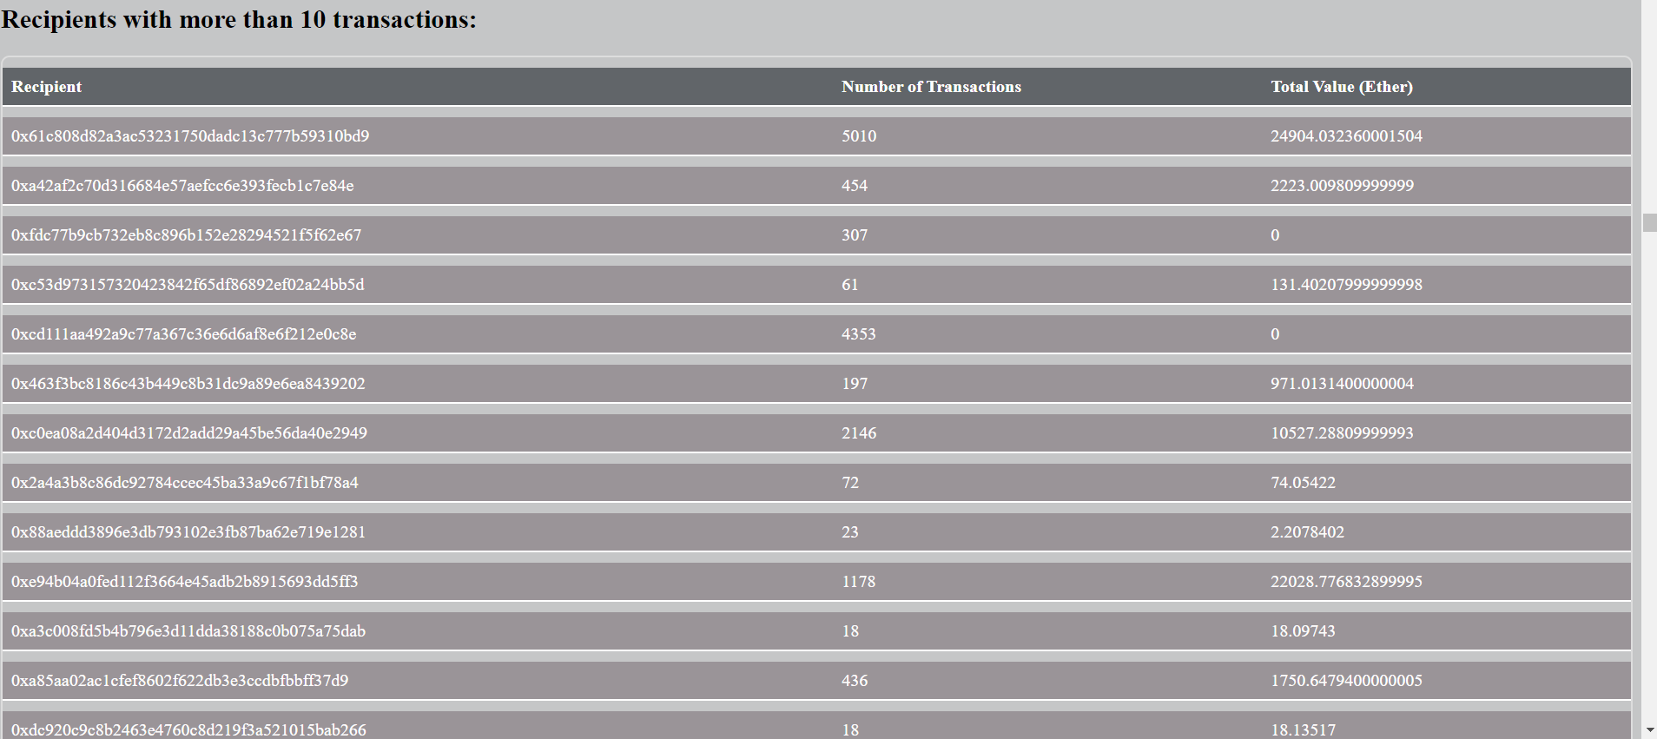
Outputs: 5. Suspicious Addresses

Slide 16
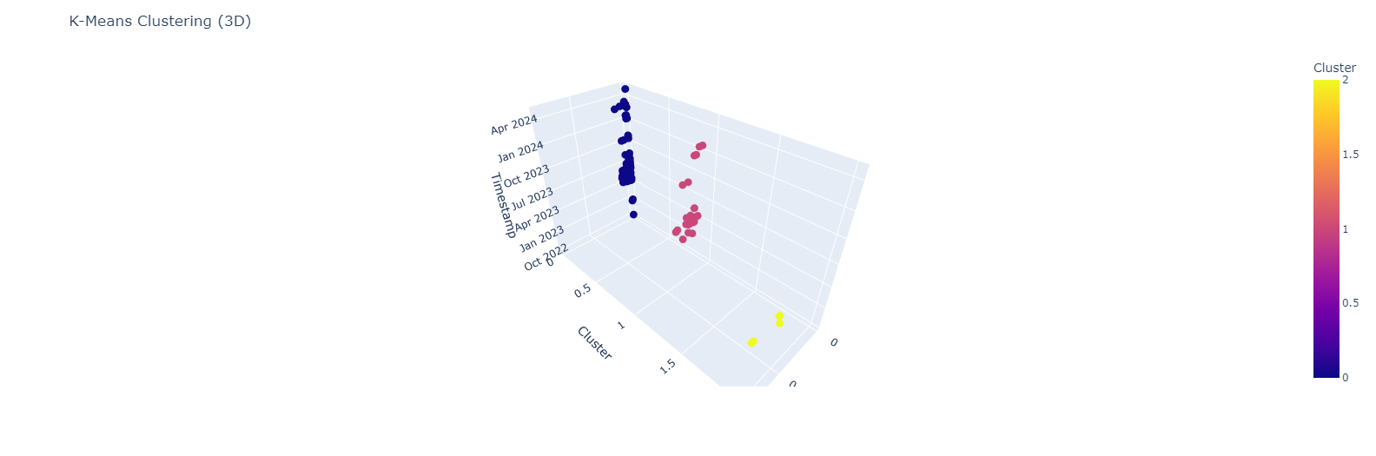
Outputs: 6. K means Clustering

